Slide 1
An Introduction to
Apprenticeships
and
T Levels

Slide 2
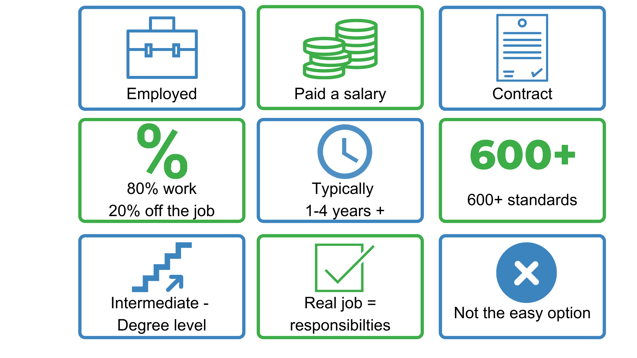
What are apprenticeships?
Notes:
So what is an apprenticeship?
An apprenticeship is a real job, with a real employer, where the apprentice will work full-time whilst also studying towards a qualification.
So you could be an apprentice working for Sky as a journalist, for example, whilst also studying and gaining a qualification in journalism.
PAID A SALARY
As it’s a real job, you will earn a wage – and it can be a really good salary too! The salary of an apprentice can vary from employer to employer. Legally, an employer must pay an apprentice the National Minimum Wage for apprentices, which is currently £4.30 per hour. This is lower than the normal National Minimum Wage, but it recognises that some people will be going into their first job with little or no experience.
The good news is that lots of employers pay a lot more than the National Minimum Wage for apprentices, with some local employers offering starting salaries of £xx,xxx and other national employers even offering starting salaries over £15,000-£20,000.
I have pulled together some local vacancy information which I will show you in a little while, so you can see some real examples of local and national apprenticeships available and see what types of salaries are being offered.
It’s important to remember that if you see an apprenticeship you’re interested in, don’t be put off by the pay if it’s low: there’s room for progression and working your way to the top of an organisation.
CONTRACT
You will also get a contract of employment, holiday pay, annual leave etc – exactly the same as any other member of staff.
80% WORK 20% OFF-THE-JOB
The apprentice will spend 80% of their time ‘on-the-job’ (doing their role), and 20% of their time ‘off-the-job’, studying or working towards their qualification.
This study element (off-the-job) would take place with a training provider, who will help them to achieve the qualifications and make sure they complete their apprenticeship.
Training providers could be colleges, Universities or independent training provider organisations, who deliver the training/teaching element of the course.
The employer will also support the apprentice, helping an apprentice to gain qualifications and valuable new skills and experience. As well as their time, employers also pay the fees of the apprentice’s training, showing their investment in the apprentices development.
TYPICALLY 1 – 6 YEARS
An apprenticeship typically takes 1 to 4 years to complete (sometimes up to 6 for some areas like a Solicitor). As a minimum, all apprenticeships must last for a minimum of 12 months.
The total duration will depend on the delivery model that the employer selects (how the mixture of training and working is delivered), the level (which we will come onto explain) and the subject they are studying.
600+ STANDARDS and INTERMEDIATE – DEGREE LEVEL
There are more than 600 different apprenticeship standards covering many different levels of apprenticeships, from Level 2 (which is the equivalent of 5 GCSEs), all the way up to Level 7, which is masters level. So you can actually work your way towards gaining a degree or masters through an apprenticeship.
We will discuss this more shortly.
REAL JOB = RESPONSIBILITIES and NOT THE EASY OPTION
As I said before, it’s a real job and so it’s important to remember that apprenticeships aren’t the ‘easy option’.
Holding down a full time job and studying takes a certain skill and commitment, and it won’t be right for everyone.

Slide 3
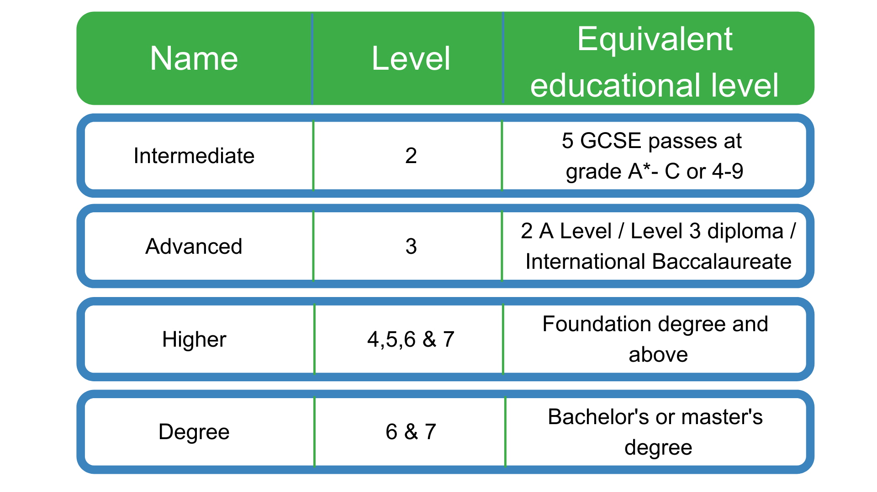
The levels of apprenticeships
Notes:
Each apprenticeship has a level which will falls into one of the four categories above: Intermediate apprenticeships, Advanced apprenticeships, Higher apprenticeships and degree apprenticeships.
The equivalent educational level column helps to explain what level the qualification at the end of the apprenticeship will be in comparison to more familiar qualifications, like GCSEs and A Levels.
So you can see that if you do a level 3 (advanced) apprenticeship, once you have qualified you’ll have gained a qualification that is equivalent to 2 A Levels, a level 3 diploma or other equivalents, like IB’s or BTECs.
The level of apprenticeship you start at will depend on the kind of job that you are applying for.
It’s really important not to be held back by only looking for a particular level e.g. degree apprenticeships. Apprenticeships work a bit differently to school which can be confusing, as lots of students think that they should progress onto the next level, so if you leave after GCSEs you should do a Level 3 and if you finish after A Levels you should go for a degree apprenticeship, but this isn’t always the case.
Depending on the sector and apprenticeship, it may be that you need to start at advanced or higher level and work your way up, or that brilliant apprenticeships are only offered at Level 2 or 3 – for example, Journalism is only offered at Level 3 because that is all the industry requires.
Equally, you may be entering a completely new sector or industry that you haven’t studied or worked in before, and so may need to do a Level 2 or 3 to enter the world of work and get that understanding.
Doing a job is completely different to getting a GCSE or A Level and that’s why it can be a bit confusing.
It is very important to keep an open mind so that you can explore all of the opportunities available and have multiple options available when applying.

Slide 4
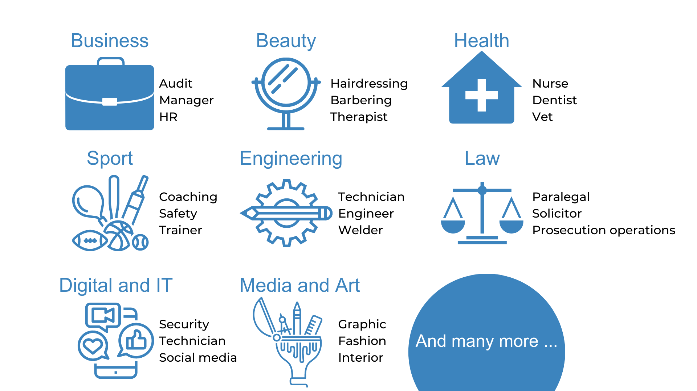
The range of apprenticeships
Notes:
Presenter notes: Please add in some local opportunities to the slide above (a mixture of traditional and non-traditional job titles) to also bring the range of the local offer and facilitate discussions below.
We’re now going to take a look at the different job roles available through an apprenticeship and when we talk about apprenticeships, people often start to think of Plumbing, Electrical and some of the other construction trades. There are many brilliant apprenticeships in these areas, but there are also hundreds of new apprenticeships in exciting areas that you might not know exist.
Suggested interactivity: Ask the audience ‘does anyone know of any apprenticeships that they might expect to see on this list?’
Once completed, click on for the image.
The range of apprenticeship job roles out there is amazing.
This slide gives you an idea of the huge range of apprenticeships available and this is just a taster – there are now over 600+ different apprenticeship standards available, resulting in over 1,500+ different job roles.
You could start an apprenticeship in hundreds of occupational areas. Some will amaze you!
Suggested interactivity: Depending on the time available…
Activity idea: Pick out a few of the job roles to discuss – will depend on the audience.
Activity idea: Can anyone spot an apprenticeship on the screen that has surprised them?
Activity idea: Does anyone know someone who is doing an interesting apprenticeship?

Slide 5



























Which employers offer apprenticeships?
Notes:
Presenter notes: Please update this slide with local companies if you feel that the logos are not representative of your area. Please include small and large organisations.
Equally, the range of employers offering apprenticeships is incredible.
This slide shows you some really familiar logos of big companies in England who all recruit apprentices.
Some of these employers may not be recruiting currently, but you will be able to track their recruitment updates on their websites or social media.
Around 50% of apprenticeships started are with large companies like this, but 50% will be with smaller local companies.
It can be tempting to think that the ‘best’ apprenticeships are just with the big, well-known companies, but many of the smaller employers have absolutely brilliant schemes that enable fast-track career progression for their apprentices, so it’s really important to do your research and not to ignore smaller employers because they can be just as good.
Presenter notes: Please include an example of a local company in the town that you are delivering in.
An example of a small local company is…X who employs apprentices in job roles like X and X etc.

Slide 6
Apprenticeships in the local area
Job opportunity | Closing date | Weekly salary | Annual salary
Vehicle Maintenance L3 | 1st Oct | £172.00 | £8,944
Carpenter L2 | 27th Sep | £172.00 | £8,944
Archaeological Technician L3 | 11th Oct | £342.18 | £17,000+
IT Support L3 | 4th Oct | £200.00 | £10,400
Hairdresser L2 | 15th Nov | £129.00 | £6,708
Account Manager L5 | 1st Oct | £375.00 | £19,000+
Notes:
Presenter notes: Please update this slide with relevant examples for your audience
Search through Find an apprenticeship using the establishment postcode and find some interesting jobs.
Try to find a selection of closing dates so that you can reinforce the need to be using Find an apprenticeship regularly
Try to find a range of salaries so that you can show that there are employers who are prepared to pay more
Try to find a job title that might sound a bit confusing and then explain what that role really is – make it sound exciting and explain that they should not be put off by the titles of some jobs, it’s important they read the job advert attached to it.
Think about STEM vacancies. Can these be showcased more?
This slide shows a range of vacancies that I could find.
You will notice that they all have different closing dates – this is one big different to applying for university.
If you do see a closing date, it’s important that you don’t wait until the very end to submit your application. We are now finding from talking to employers, if they receive a huge number of applications, they may decide to close the application window early.
You will also notice the range of different salaries too – this is because employers can decide what to pay (as long as it meets the national minimum wage for apprentices of £4.30)
Presenter notes: It might be useful to have the find an apprenticeship website open to show them current examples and what the site looks like. This is also relevant for the next slide.

Slide 7
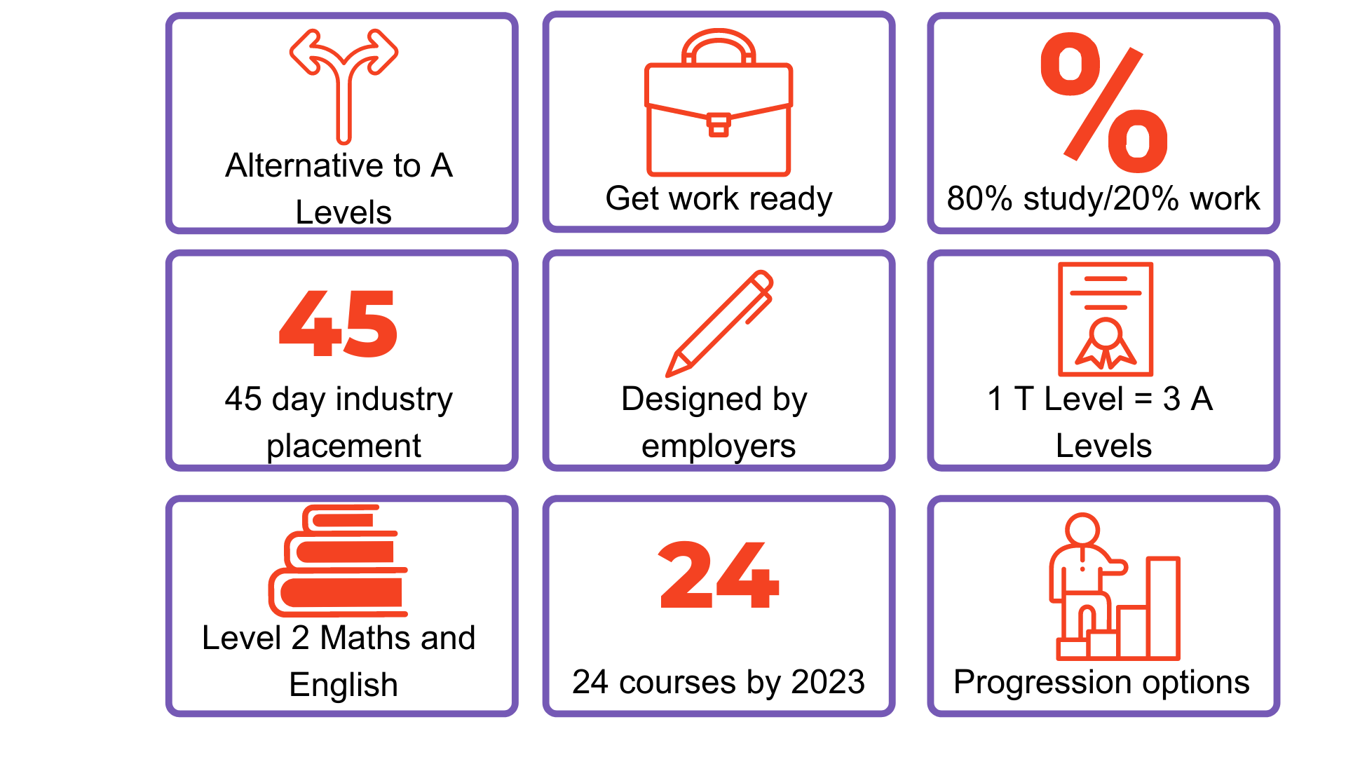
What are T Levels?
Notes:
SO WHAT ARE T LEVELS IN A BIT MORE DETAIL?
ALTERNATIVE TO A LEVELS and GET WORK READY
T Levels are a practical, employer-led alternative to A Levels, designed to get students work ready.
80% STUDY / 20% WORK
T Levels work oppositely to apprenticeships. So for T Levels, students spend 80% of time in the classroom or in specialist facilities, learning the theory and developing practical skills and the other 20% of their time on an industry placement with an employer putting this into action (apprenticeships are the opposite with 80% of the time at work and 20% training/studying).
A school, college or training provider (a training provider is an organisation that offers vocational courses and training to young people and adults), delivers the course. Which schools/colleges/providers are delivering T Levels varies by area, but we will come onto this a little bit later.
45 DAY INDUSTRY PLACEMENT
Students will spend a minimum of 45 days/315 hours (which is a minimum of 9 weeks) on a meaningful industry placement. This is measured in hours so it can be split across two employers if needed.
This is unlikely to be paid as it's part of your course of study, but support for travel and expenses may be available.
The time spent in the workplace can be carried out as day release, in one solid block, multiple smaller blocks or a mixture of any of these models, depending on what works for the provider, student and employer.
The T Level provider is responsible for sourcing your industry placement, however, in some cases, the provider may encourage you to research and self-source your preferred employers for your placements. Providers should help you to identify suitable employers that are relevant to your chosen specialism at the appropriate level.
DESIGNED BY EMPLOYERS
T Levels are designed by employers to ensure that students are learning the skills employers are looking for, improving their employability.
Nearly 300 employers have been involved in developing T Levels, ranging from small local businesses to large multinationals, including Amazon, Fujitsu, EDF Energy and Skansa.
1 T LEVEL = 3 A levels
You study one T Level subject unlike A Levels where you’d typically study 3, and you would gain a nationally recognised certificate, with 1 T Level equivalent to 3 A Levels.
When you pass your T Level, you will get a nationally recognised certificate showing the overall grade you achieved – pass, merit, distinction or distinction*. It will also give you details of what you studied on the course to help you move into skilled employment or an apprenticeship.
Just like A Levels, T Levels also attract UCAS points. A T Level Distinction* is worth the same as 3 A Levels at A* - and will be recognised by Universities so you can choose to continue studying if you wish.
LEVEL 2 MATHS AND ENGLISH
If not already achieved, then students could also work towards Level 2 maths and English.
24 COURSES BY 2023
There are 13 different T Level subjects currently available at selected schools/colleges across England as of this September, with a further 14 more by 2023.
PROGRESSION OPTIONS
When you complete a T Level, you could progress into employment, apprenticeships or further study, including full-time university.
WHO ARE T LEVELS FOR?
T Levels are ideal if you have finished your GCSEs and want the knowledge and experience to get straight into employment, an apprenticeship or higher education. They will especially suit you if you know the rough area of industry you want for your career (although this is not required – many students will still do a T Level in an industry they are interested in), and if you prefer a practical course designed by employers but also want to spend time learning in the classroom.

Slide 8
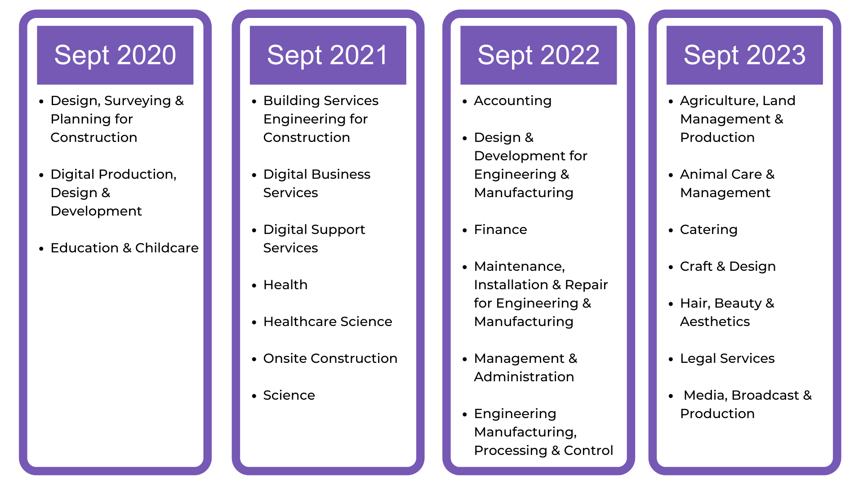
Courses available
Notes:
WHICH T LEVELS ARE AVAILABLE?
T Levels are being rolled-out which means that each year, more and more will be available.
T Levels started in 2020 with three courses:
Design, Surveying and Planning
Digital Production, Design and Development
Education & Childcare
7 more exciting T Levels have started this September, ranging from Digital services, Health, Construction and Science.
As you can see, more and more will be available from next September onwards when you may be leaving school/college.
With each of these subjects, there will be a core curriculum that you will study, covering the concepts, theory and principles for the subject. At some point during the course, you will take a specialism. When this is will depend on which subject you do. The number of specialisms also varies depending on the T Level.
For each subject, if you haven’t achieved English and Maths Level 2 (which is GCSE grade 4 or above or Functional Skills level 2 pass), then you will need to work towards this which your college, school or training provider will help you to achieve.
Entry requirements vary for different T Levels – this is up to the T Level provider to set, so it’s important to research this when looking for T Levels near you.
Suggested interactivity: Facilitate a group discussion about the different T Level courses available:
Are there any subjects on here that you’re surprised by?
Are there any which you may not know what they are or what they involve?
Are there any you’re excited by?
Suggested interactivity: You could go onto the T Levels website and open up one of the courses the student finds interesting to explore it in more detail, looking at:
What the core curriculum is
What the specialisms are
What progression it leads to
Any other useful information they find interesting
The website is as follows: https://www.tlevels.gov.uk/students/subjects
It is important to check which courses are actually available near you and if places are available, as not all providers will be delivering the full range of options and places may have been filled…

Slide 9
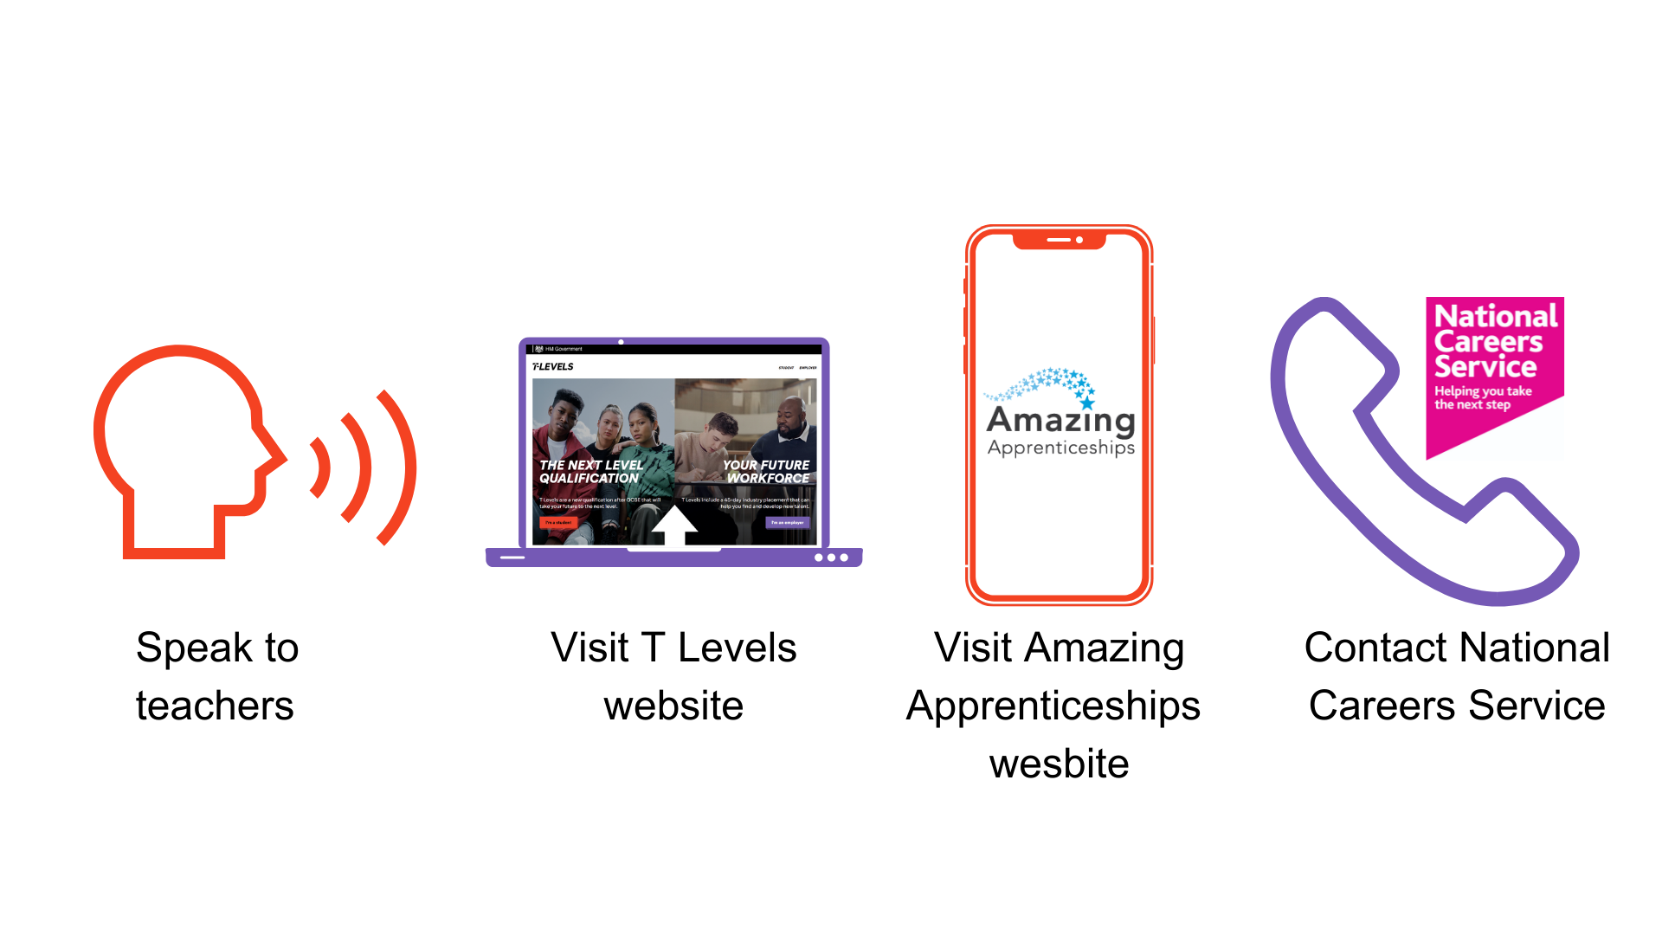
Further information
Notes:
Thank you so much for listening today, it has been an absolute pleasure meeting and talking to you all.
I hope that you have found today useful.
Remember, there is lots of support out there to help to guide you into the right choice for you after this session.
You can speak to your teachers here at school who can point you in the direction of the Careers Leader who will be able to tell you more about apprenticeships. They are also in touch with us and so we can answer your questions/come back in and run further sessions if lots of people still want further help.
You can also visit tlevels.gov.uk, which is the government website containing information about T Levels and where you can go to for more information and continue learning about T Levels.
There are also lots of helpful resources on the Amazing Apprenticeships website.
You can contact the National Careers Service, who can help to give you advice and guidance.

Slide 10
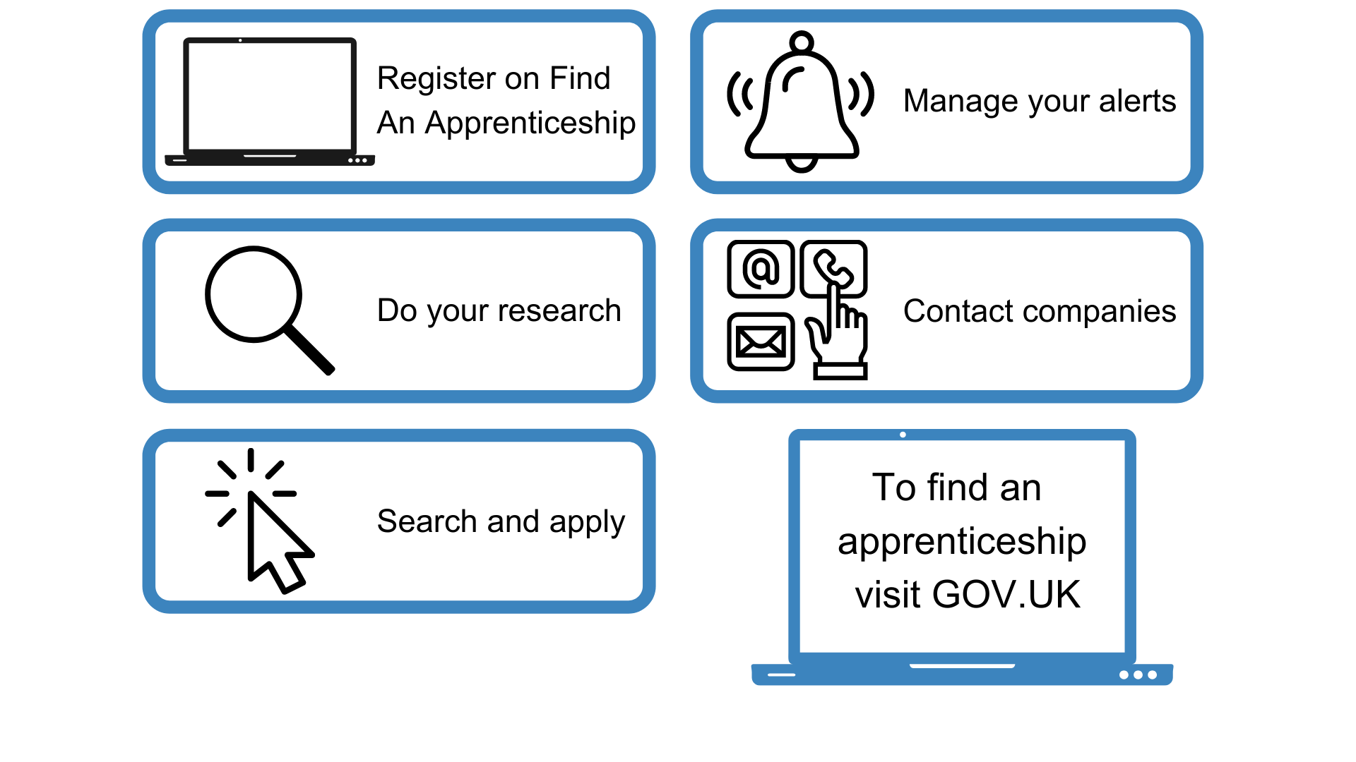
How do you find an Apprenticeship or
T level?
Notes:
Where did I find these vacancies? So one of the first places to look is Find an apprenticeship, the government portal for apprenticeship jobs.
1. It’s really important that you register. Search the internet for ‘Find an apprenticeship’ and it will come up as the first link
The search page is on gov.uk, an official government site.
Once you register you’ll receive an account activation code by email. After activating your account, you’re ready to start applying for apprenticeship vacancies.
2. Have a look at the different jobs that are being advertised. Remember, this is a live jobs site so it may be that you need to try and few different searches or to broaden how far you are looking to find jobs that you are interested in.
As I noted earlier, it is important to remember that it is expected that the number of vacancies on Faa will have reduced over this period of the pandemic, but that we are seeing these grow again as the economy begins to recover.
In the meantime, please do not be disheartened if you take a look and cannot find anything immediately or in the coming weeks.
Typically, there will be lots of options for you to choose from! And many employers are up and recruiting again and will be in the future. Be sure to do lots of research and look on employer websites and other jobs sites too.
3. Start applying for jobs that interest you. You need to remember that typically, some of the bigger companies will advertise quite early in the year (e.g. Autumn) for apprentices to start the following September so please don’t leave it until the last minute or you might be disappointed to have missed a great opportunity.
Recruitment timeframes may have changed this year and so it will be important to stay on top of these.
4. Set up your alerts. A great feature of this system is that you can get it to do all the hard work for you. You can manage your alert settings so that you receive text messages and emails when jobs come up that you might be interested in
5. Employers are always telling us that the applicants that really stand out to them, are those that have made a bit of extra effort. You could consider contacting the company and asking them if they have any virtual open days coming up or other opportunities to engage with them. That will look really impressive on your application and can give you an advantage over other applicants.

Slide 11
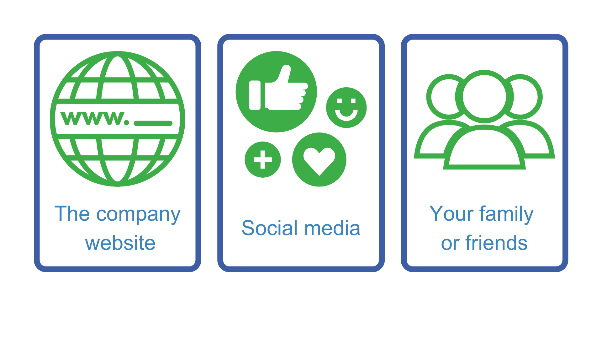
Where else to look?
Notes:
Whilst Find an apprenticeship is a great place to start looking for apprenticeships, it is not the only place.
If you have a particular employer in mind, visit their website and see if you can sign up for recruitment alerts or if they send out a newsletter.
Make sure you follow their careers pages on social media using Facebook, Twitter and Instagram too as they will probably use this as a way to promote their vacancies.
We have spoken to lots of apprentices and quite often, they will say that they actually heard about their job through a family member or friend. So make sure you tell everyone you can think of that you’re looking for an apprenticeship and you never know what might come through!
There are lots of other job search sites out there, including apprenticeships.gov.uk, where you can flick through online profiles for some of the UK’s top apprentice employers.
Definitely spend some time looking into the different types of employers. There will be a real mix from your local council who might have a jobs page for young people, through to bigger recruitment sites too.

Slide 12

Thank you for your time today, I hope you found the information useful & whatever you choose as your future pathway, I wish you good luck.
Donna

